Slide 1

Module 7: Distributed Web-based System

Slide 2
Contents
Distributed Web Based
Architecture
Processes Communication
Overview of Distributed Computing Platforms
Cluster
Cloud
Grid

Slide 3
What is Distributed Web Based System?
The Web → Distributed Web Based
Fundamentally similar to Distributed Systems
Millions of servers
Each server hosting thousands of documents

Slide 4
Traditional Web Based Systems
Simple Client Server Architectures
It consisted of Process that has access to local file system storing documents
URL (Uniform Resource Locator) → used to refer a resource
It specifies the location of the document
Client interacts with browser to access documents available with server
HTTP (Hyper Text Transfer Protocol): Standardized communication between browser and web server

Slide 5
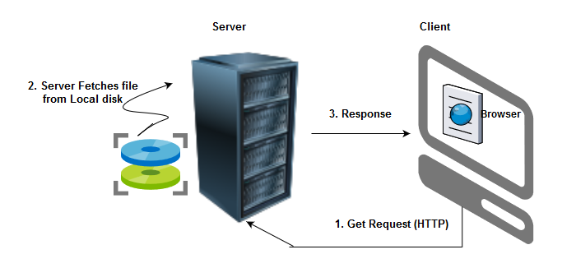
Overview of Traditional Web Based System

Slide 6
Web Documents
All information shared in web as documents
It includes, Audio, Video and Text
HTML, XML
MIME – Multipurpose Internet Mail Exchange

Slide 7
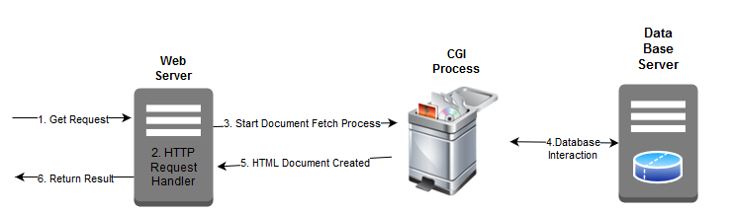
Multi-tiered Architectures

Slide 8
Disadvantages with 3 Tiered Architectures
Decrease in Performance
Application and Database server are potential bottle necks
Solution:
Caching and Replication

Slide 9
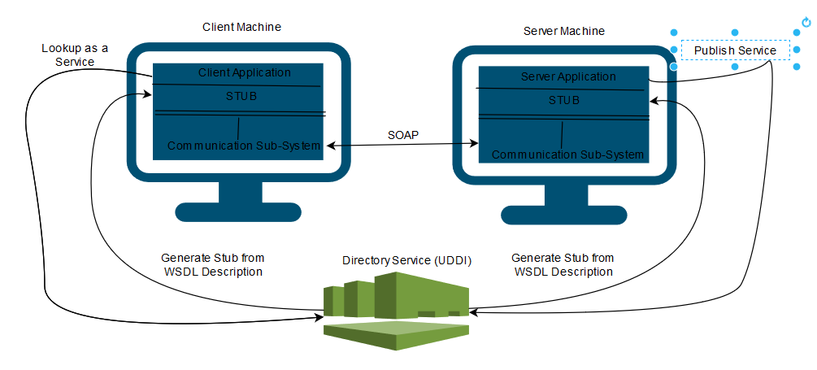
Web Services

Slide 10
Web Server Clusters
Web server may get overloaded
To replicate
Horizontal Distribution

Slide 11
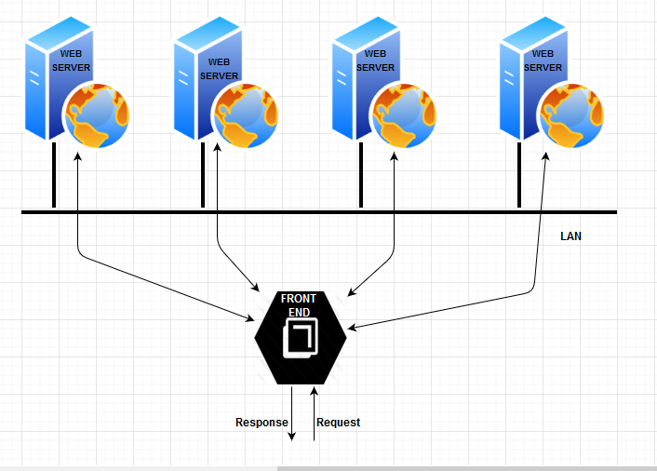
…Continued

Slide 12
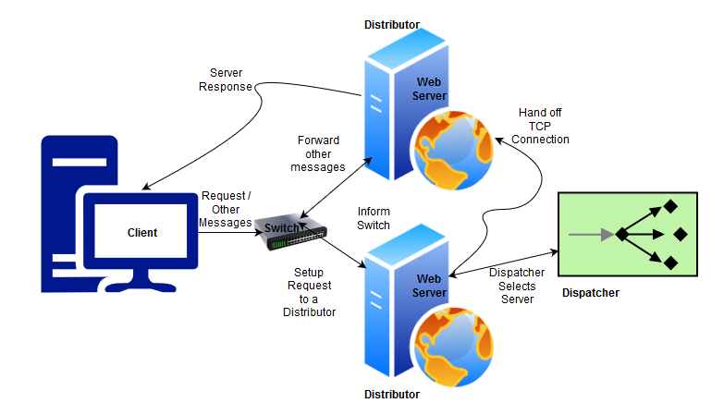
Scalable Content Aware Web Cluster

Slide 13
Connections
Non - Persistent
Each request to a server required setting up a separate connection
When the server had responded, the connection was broken down again
Persistent
Connection is not broken after response

Slide 14
Caching and Consistency
Ensuring access to Web documents meets stringent performance and availability requirements
Cache wherever possible
Maintain Consistency

Slide 15
Types of Caching
Shared Cache
A Web proxy accepts requests from local clients and passes these to Web servers. When a response comes in, the result is passed to the client
Hierarchical
In addition to shared cache, place cache to cover regions, states, countries etc.
Reduced network traffic
Co-operative
Also called distributed caching

Slide 16
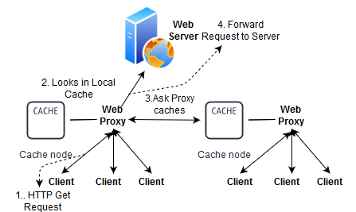
Distributed (or) Co-operative Caching

Slide 17
Overview of distributed computing platforms

Slide 18
Distributed Computing Paradigms
Cluster Computing
Cloud Computing
Grid Computing

Slide 19
Cluster Computing
Loosely or tightly connected nodes
Attributes of cluster
High Availability
Load-Balancing
Scalability

Slide 20
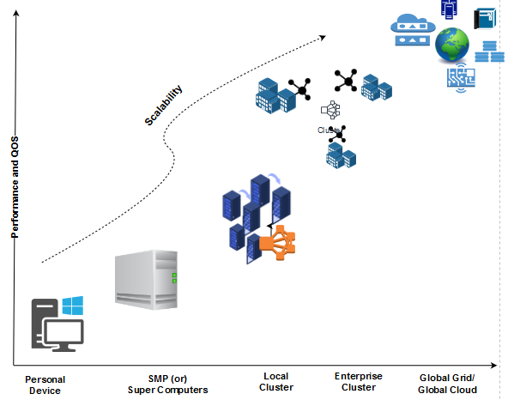
Scalable Distributed Computing

Slide 21
Grid Computing
Collection of distributed (heterogeneous) resources
To execute large scale applications

Slide 22
…Continued…
Computational Grid also called meta computer
Computational grid comes from an analogy with the electric power grid
Electric power is ubiquitous

Slide 23
History of Grid Computing
Early 90’s gigabit testbed program was developed
Joint venture by NSF, DARPA, CNRI
Goal : To investigate potential architecture for a gigabit/sec network testbed and to explore usefulness for end-users
5 Testbeds : CASA (southwest), MAGIC and BLANCA (Midwest), AURORA and NECTAR (northeast), VISTANET (southeast)

Slide 24
GRID Computing
Grids are about large-scale resource sharing.
Spanning administrative boundaries.
Central processors, storage, network bandwidth, databases, applications, sensors and so on
Problem solving in dynamic, multi-institutional environment.
Organizing geographically distributed computing resources
So that they can be flexibly and dynamically allocated and accessed
Providing such capabilities, where Sharing is highly controlled, clear definitions of exactly what is shared, who is allowed to share, and the conditions under which sharing occurs.

Slide 25
Elements of Grid Computing
Resource sharing
Computers, data, storage, sensors, networks, …
Sharing always conditional: issues of trust, policy, negotiation, payment, …
Coordinated problem solving
Beyond client-server: distributed data analysis, computation, collaboration, …
Dynamic, multi-institutional virtual organizations
Community overlays on classic org structures
Large or small, static or dynamic

Slide 26
Virtual Organizations
A set of individuals and/or institutions defined by a set of sharing rules
The sharing is highly controlled, with resource providers and consumers defining clearly and carefully just what is shared
An example: the set of application service providers, storage service providers, cycle providers and consultants engaged by a car manufacturer to plan for a new factory
Another example: industrial consortium building a new aircraft

Slide 27
More Formal Definition of Grids
A grid is a system that:
Coordinates resource sharing in a de-centralized manner (i.e., different VOs).
Uses standard, open, general purpose protocols and interfaces.
Delivers non-trivial qualities of service.
Guaranteed bandwidth for application.
Guaranteed CPU cycles.
Guaranteed latency.

Slide 28
Computational Grid Applications
Biomedical research
Industrial research
Engineering research
Studies in Physics and Chemistry

Slide 29
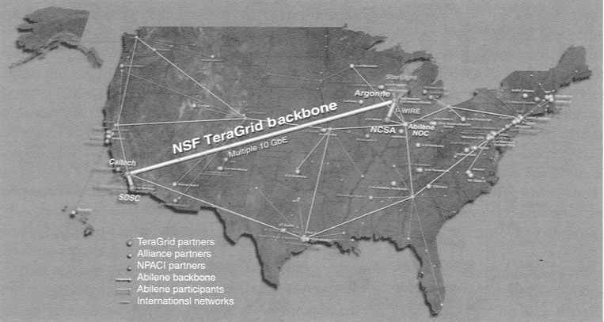
TeraGrid is an Important Project developed by the National Science Foundation (NSF).
Slide obtained from B. Wilkinson, http://sol.cs.wcu.edu/~abw/CS493F04/

Slide 30
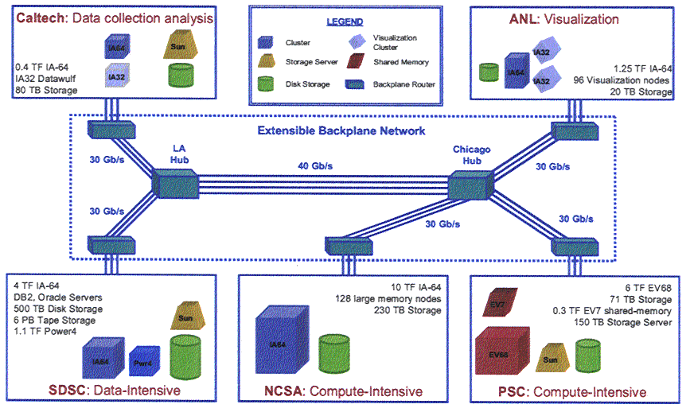
TeraGrid
Slide obtained from B. Wilkinson, http://sol.cs.wcu.edu/~abw/CS493F04/

Slide 31
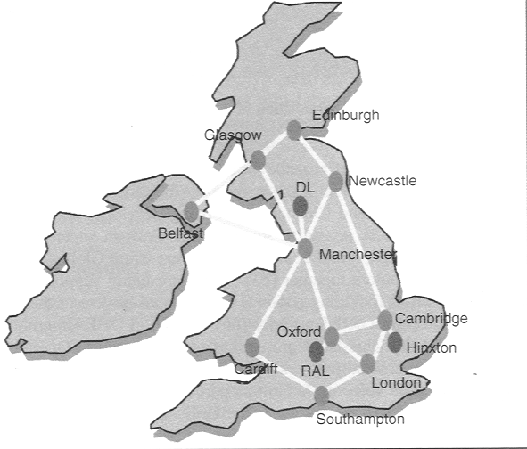
UK e-Science Grid
Slide obtained from B. Wilkinson, http://sol.cs.wcu.edu/~abw/CS493F04/

Slide 32
Virtual Organization
The members of this class represent a VO within the university.
The resources of the VO include:
The laptops, workstations, and printers belonging to the individuals of the VO
Does this bring up any issues worth concerning yourself about?

Slide 33
Problems with Virtual Organization
Want to tightly control who may use these resources and how they may be used – Need for security
Security:
Want to tightly control who may use these resources and how they may be used.
How about A and B wanting to use your printer at the same time (which happens to be 8:30 AM). Is this a problem?

Slide 34
Solutions for sharing resources
What if X forgot Y’s IP address and cannot gain access to his laptop? How could this be addressed (assuming you want it addressed)?
You could provide an information service that could tell X how to find the laptop.
You would also have to deal with allocating multiple resources to a user, e.g., a laptop to write a paper and a printer to print it out. Thus need a resource manager.
Also need a way to monitor your application executing in your VO Grid.

Slide 35
Grid Computing Software Infrastructure

Slide 36
Open Grid Services Architecture
Developed by the Global Grid Forum to define a common, standard, and open architectures for Grid-based applications.
Provides a standard approach to all services on the Grid.
VO Management Service.
Resource discovery and management service:
Job management service.
Security services.
Data management services.
Built on top of and extends the Web Services architecture, protocols, and interfaces.

Slide 37
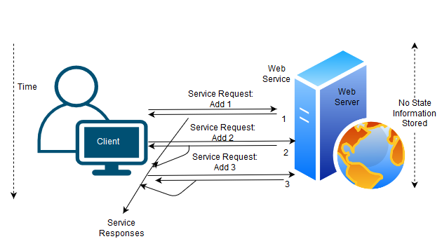
A stateless Web Service invocation

Slide 38
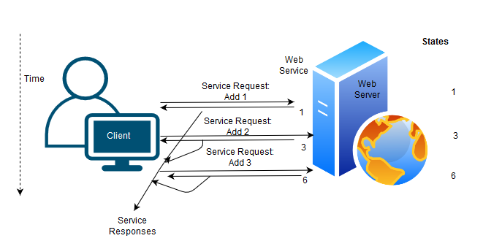
A stateful Web Service invocation

Slide 39
Relationship between OGSA , WSRF, and Web Services
OGSA : Open Grid Services Architecture
set of standards defining the way in which information is shared among diverse components of large, heterogeneous grid systems
WSRF : Web Services Resource Framework
Enables stateful Web-services interactions

Slide 40
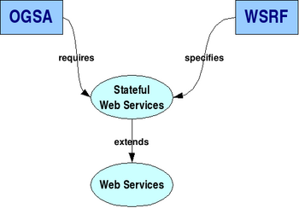
…Continued…

Slide 41
WSRF
Web Services Resource Framework
a specification developed by OASIS(Organization for the Advancement of Structured Information Standards )
WSRF specifies how to make Web Services stateful.
joint effort by the Grid and Web Services communities.
WSRF provides the stateful services that OGSA needs.
OGSA is the architecture, WSRF is the infrastructure on which that architecture is built on.

Slide 42
Standards Bodies
The primary standards-setting body is¹:
Global Grid Forum (GGF)
Started in 1998
Meets three times a year, GGF1, GGF2, GGF3 …
More than 40 organizations involved and growing …
Others:
W3C consortium (Worlds Wide Web Consortium)
Working on standardization of web-related technologies such as XML
See http://www.w3.org
OASIS (Organization for the Advancement of Structured Information Standards)
IETF, DMTF

Slide 43
Standards in the Web Services World
XML introduced (ratified) in 1998
SOAP (Simple Object Access Protocol) ratified in 2000
Web services developed
Subsequently, standards are continuing to be developed:
WSDL (Web Services Description Language)
WS-* where * refers to names of one of many standards

Slide 44
Standards in the grid computing world
Open Grid Services Architecture (OGSA)
First announced at GGF4 in Feb 2002
OGSA does not give details of implementation.

Slide 45
Globus Project
Open source software toolkit developed for grid computing.
Roots in I-way experiment.
Work started in 1996.
Four versions developed to present time.
Reference implementations of grid computing standards.
Defacto standard for grid computing.

Slide 46
Globus Version 4
A “toolkit” of services and packages for creating the basic grid computing infrastructure
Higher level tools added to this infrastructure
Version 4 is web-services based
Some non-web services code exists from earlier versions (legacy) or where not appropriate (for efficiency, etc.).

Slide 47
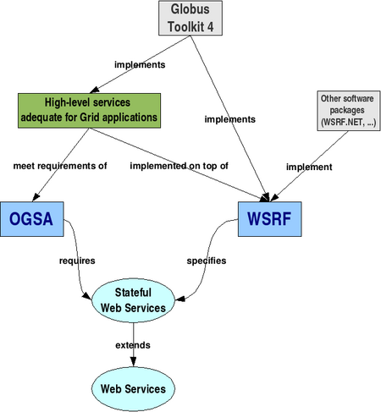

Slide 48
Globus
Five parts:
Common Runtime
GT Core for building new services
Security
To provide secure access. Based upon Grid Security Infrastructure (GSI)
Execution management
Initiation, monitoring, management, scheduling and coordination of executable programs (jobs)
Data management
Discover, transfer, and access large data
Information services
Discover & monitor dynamic services

Slide 49
…Continued
Each part comprises a set of web services and/or non-web service components.
Some built upon earlier versions of Globus.

Slide 50
GRAM (Grid Resource Allocation Manager)
G
T
4
Delegation
Service
Community
Scheduler
Framework
[contribution]
Python WS Core
[contribution]
C WS Core
G
T
3
Community Authorization
Service
OGSA-DAI
[Tech Preview]
Web Services Components
WS
Authentication
Authorization
Reliable
File
Transfer
Grid
Resource
Allocation Mgmt
(WS GRAM)
Monitoring
& Discovery
System
(MDS4)
Java WS Core
G
T
2
Pre-WS
Authentication
Authorization
GridFTP
Grid
Resource
Allocation Mgmt
(Pre-WS GRAM)
Monitoring
& Discovery
System
(MDS2)
C Common
Libraries
Non-WS
Components
G
T
3
Replica
Location
Service
XIO
G
T
4
Credential
Management
Security
Data Management
Execution Management
Information Services
Common Runtime

Slide 51
Cloud Computing

Slide 52
What is Cloud Computing?
Cloud Computing is a general term used to describe a new class of network based computing that takes place over the Internet,
basically a step on from Utility Computing
a collection/group of integrated and networked hardware, software and Internet infrastructure (called a platform).
Using the Internet for communication and transport provides hardware, software and networking services to clients
These platforms hide the complexity and details of the underlying infrastructure from users and applications by providing very simple graphical interface or API (Applications Programming Interface).

Slide 53
…Continued
In addition, the platform provides on demand services, that are always on, anywhere, anytime and any place.
Pay for use and as needed, elastic
scale up and down in capacity and functionalities
The hardware and software services are available to
general public, enterprises, corporations and businesses markets

Slide 54
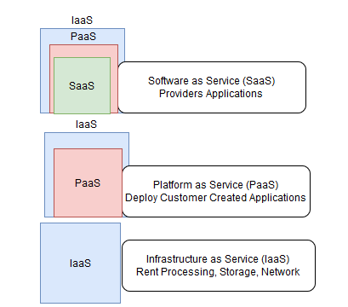
Cloud Service Models

Slide 55




Some Cloud Service Providers
SalesForce CRM
LotusLive
Google App Engine

Slide 56
Basic Cloud Characteristics
Cloud are transparent to users and applications, they can be built in multiple ways
branded products, proprietary open source, hardware or software, or just off-the-shelf PCs.
In general, they are built on clusters of PC servers and off-the-shelf components plus Open Source software combined with in-house applications and/or system software.

Slide 57
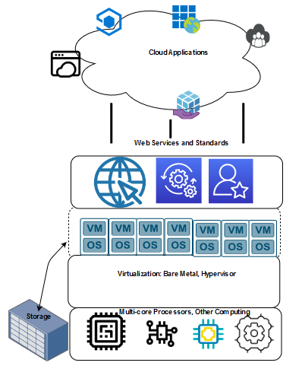
Enabling Technologies

Slide 58
SaaS
SaaS is a model of software deployment where an application is hosted as a service provided to customers across the Internet.
Saas alleviates the burden of software maintenance/support
but users relinquish control over software versions and requirements

Slide 59
PaaS
Platform as a Service - PaaS
The capability provided to the consumer is to deploy onto the cloud infrastructure consumer-created or acquired applications created using programming languages and tools supported by the provider.
The consumer does not manage or control the underlying cloud infrastructure including network, servers, operating systems, or storage, but has control over the deployed applications and possibly application hosting environment configurations.

Slide 60
IaaS
Infrastructure as a Service - IaaS
The capability provided to the consumer is to provision processing, storage, networks, and other fundamental computing resources where the consumer is able to deploy and run arbitrary software, which can include operating systems and applications.
The consumer does not manage or control the underlying cloud infrastructure but has control over operating systems, storage, deployed applications, and possibly limited control of select networking components .
Examples :
Amazon EC2
Eucalyptus
Open Nebula
… etc

Slide 61
…Continued…
Provide service –Resource Management Interface
Several types of virtualized resource :
Virtual Machine – As an IaaS provider, we should be able to provide the basic virtual machine operations, such as creation, suspension, resumption and termination, …etc.
Virtual Storage – As an IaaS provider, we should be able to provide the basic virtual storage operations, such as space allocation, space release, data writing and data reading, …etc.
Virtual Network – As an IaaS provider, we should be able to provide the basic virtual network operations, such as IP address allocation, domain name register, connection establishment and bandwidth provision, …etc.

Slide 62
….Continued…
Enabling technique - Virtualization
Virtualization is an abstraction of logical resources away from underlying physical resources.
Virtualization technique shift OS onto hypervisor.
Multiple OS share the physical hardware and provide different services.
Improve utilization, availability, security and convenience.

Slide 63
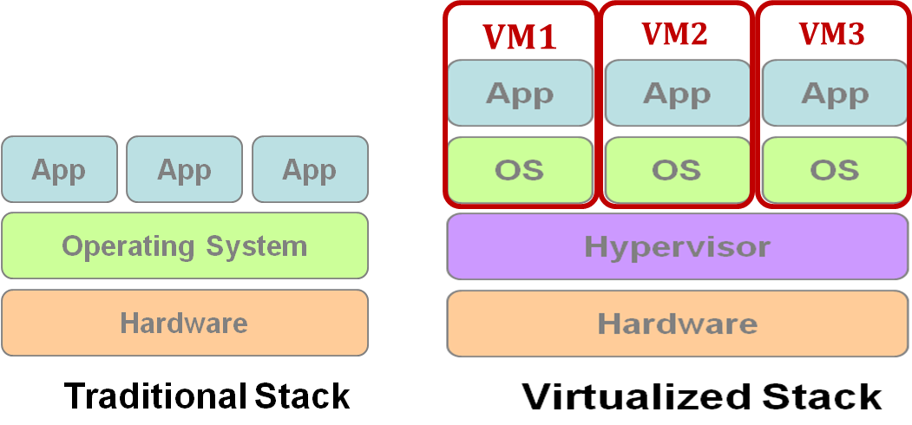
…Continued…

Slide 64
Deployment Model
There are four primary cloud deployment models :
Public Cloud
Private Cloud
Community Cloud
Hybrid Cloud
Each can exhibit the previously discussed characteristics; their differences lie primarily in the scope and access of published cloud services, as they are made available to service consumers.

